Slide 1

Hotel Revenue Analysis Project

Slide 2
Agenda
Introduction
Dataset Background
Dataset glossary
Dataset Preparation in Excel
SQL Data Pre-Processing
Hotel revenue data analysis
Hotel Revenue Dashboard
Recommendations

Slide 3

Introduction
Welcome to my presentation on Hotel Revenue Analysis, a project that combines data analytics tools to uncover key insights and optimize revenue strategies in the hospitality industry. The analysis was conducted using a comprehensive approach involving Excel for data cleaning and exploratory analysis, SQL for efficient data querying, Python for advanced analysis and automation, and Power BI for interactive visualization.
This project focuses on understanding revenue trends, identifying factors impacting performance, and generating actionable insights to support strategic decision-making. With data-driven methodologies, this analysis provides valuable recommendations for enhancing profitability and operational efficiency in the hotel industry.

Slide 4
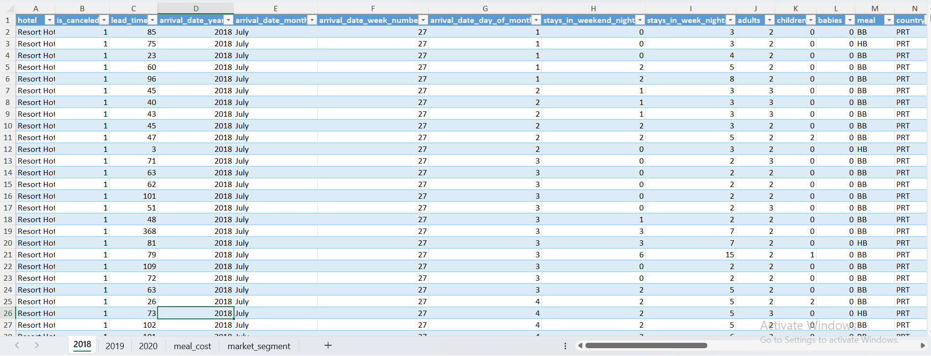
4
Dataset Background
The dataset used for this project was gathered from a hotel booking website and provides comprehensive information on hotel reservations over three years: 2018, 2019, and 2020. It includes detailed records for two types of hotels Resort Hotel and City Hotel capturing various aspects of the booking process and guest preferences

Slide 5
Dataset glossary
Field Name | Description
Hotel | Hotel (H1 = Resort Hotel or H2 = City Hotel)
is_canceled | Value indicating if the booking was canceled (1) or not (0)
lead_time | Number of days that elapsed between the entering date of the booking into the PMS and the arrival date
Arrival_date_year | Year of arrival date
Arrival_date_month | Month of arrival date
Arrival_date_week_number | Week number of year for arrival date
Arrival_date_day_of_month | Day of arrival date
Stays_in_weekend_nights | Number of weekend nights (Saturday or Sunday) the guest stayed or booked to stay at the hotel
Stays_in_week_nights | Number of weeknights (Monday to Friday) the guest stayed or booked to stay at the hotel
Adults | Number of adults
Children | Number of children
Babies | Number of babies
Cost | Cost incurred by the hotel company related to the associated meal package provided to the customer

Slide 6
Dataset glossary
Field Name | Description
Market_segment | Market segment designation. In categories, the term “TA” means “Travel Agents” and “TO” means “Tour Operators”
Distribution_channel | Booking distribution channel. The term “TA” means “Travel Agents” and “TO” means “Tour Operators”
Is_repeated_guest | Value indicating if the booking name was from a repeated guest (1) or not (0)
Previous_cancellations | Number of previous bookings that were cancelled by the customer prior to the current booking
Previous_bookings_not_cancelled | Number of previous bookings not cancelled by the customer prior to the current booking
Reserved_room_type | Code of room type reserved. Code is presented instead of designation for anonymity reasons.
Agent | ID of the travel agency that made the booking

Slide 7
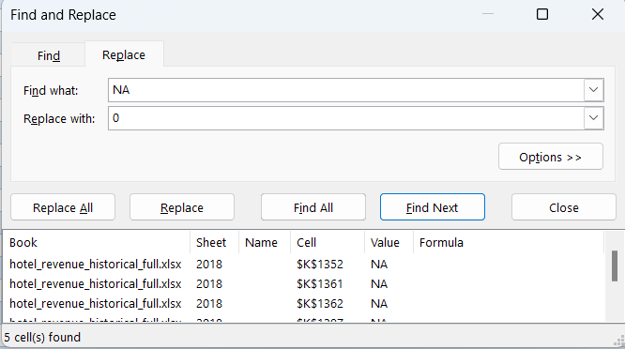
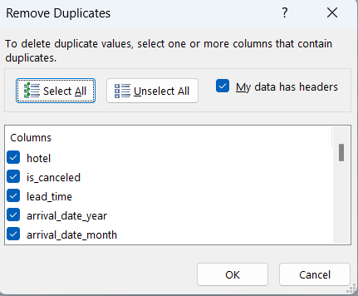
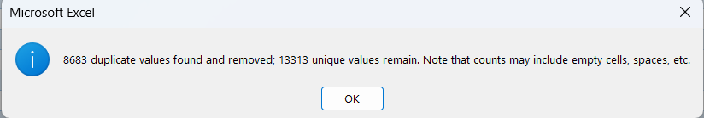

Dataset Preparation in Excel

Slide 8
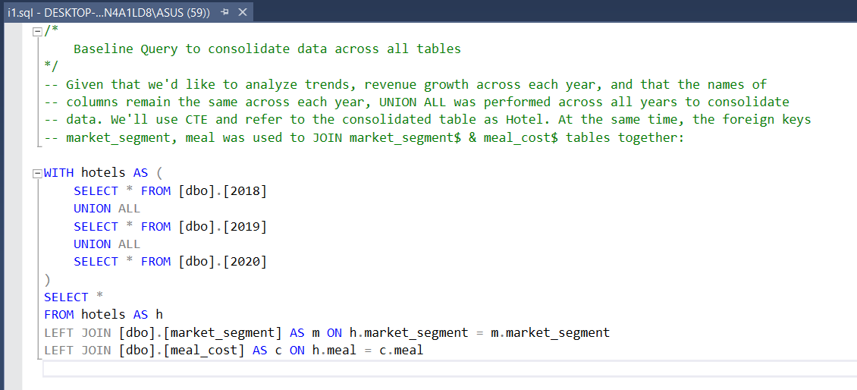
SQL Data Pre-Processing
Raw .csv file is ingested into Microsoft SQL Server Management Studio (SSMS) and SQL queries were iteratively built upon the baseline query below to obtain the final query to import into SSMS
The baseline query utilizes UNION ALL, CTE & LEFT JOINs to aggregate all sheets within the excel spreadsheet

Slide 9
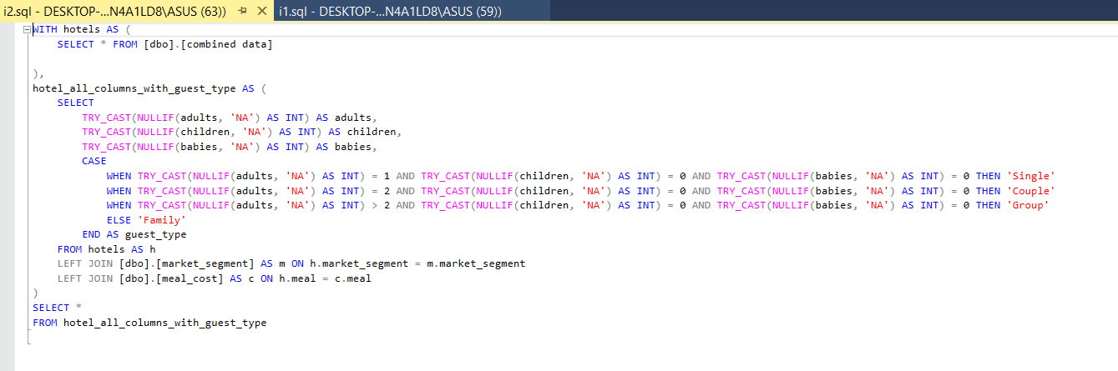
SQL Data Pre-Processing
One of the requirements was to investigate if there’s any guest-related seasonality or trends Noticing that in the dataset, there are ‘adults’, ‘children’ & ‘babies’ information for each booking made
I want to create a single column that categorizes each booking by the type of guests, they fall into 4 categories
Single
Couple
Group
Family

Slide 10
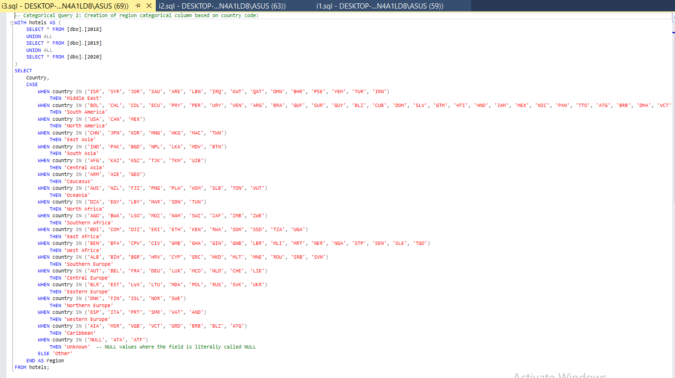
SQL Data Pre-Processing
I observed that the dataset stores the guests' countries in a three-letter country code format.
To gain deeper insights into customer behavior based on their geographical location, I plan to create a new categorical column called 'region’.
This will classify the guests into broader regions, allowing for a more comprehensive analysis of trends and patterns across different parts of the world.

Slide 11
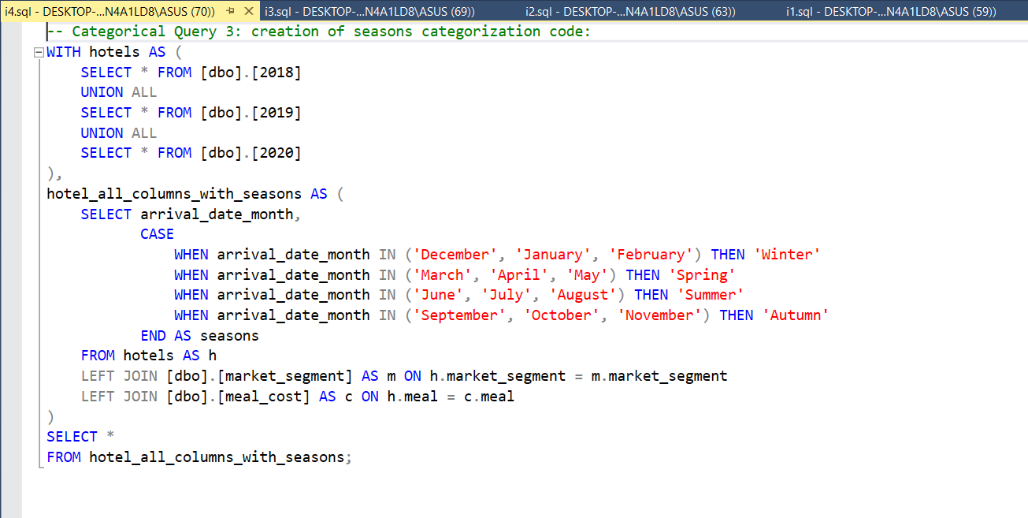
SQL Data Pre-Processing
Given that the month of arrival of guests are provided in the dataset, I’d like to categorize them by seasons:

Slide 12
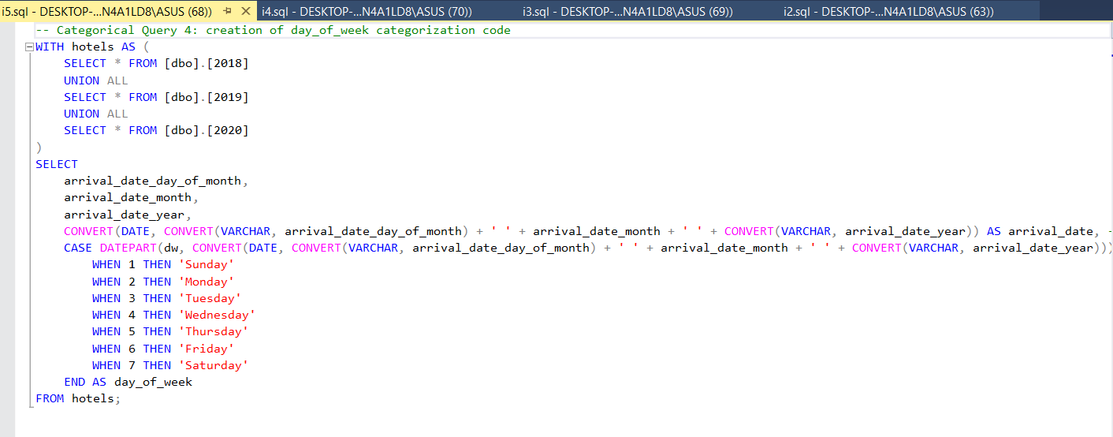
SQL Data Pre-Processing
The SQL query below utilizes DATEPART & CASE WHEN statements, as well as converting and concatenating each columns from the arrival date to extract out the corresponding day of the week in which the guests arrive in.

Slide 13
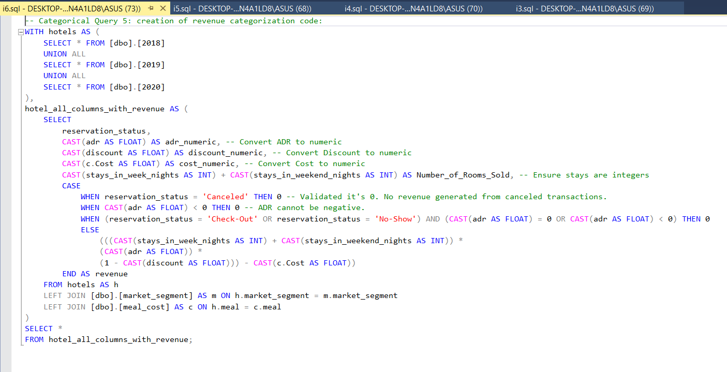
SQL Data Pre-Processing
Since we’re given the:
ADR value
# of weekdays and weekends stayed from a particular booking
% Discount corresponding for guests belong to a particular market_segment
Meal Cost of food provided to the guest
We can manipulate the ADR formula to obtain the corresponding revenue generated by each booking, this is given by:
𝑅𝑒𝑣𝑒𝑛𝑢𝑒 𝑝𝑒𝑟 𝑏𝑜𝑜𝑘𝑖𝑛𝑔 =[ × 𝑠𝑡𝑎𝑦𝑠 𝑖𝑛 𝑤𝑒𝑒𝑘 𝑛𝑖𝑔ℎ𝑡𝑠 +𝑠𝑡𝑎𝑦𝑠 𝑖𝑛 𝑤𝑒𝑒𝑘𝑒𝑛𝑑 𝑛𝑖𝑔ℎ𝑡𝑠 ×𝐴𝐷𝑅 1 −𝐷𝑖𝑠𝑐𝑜𝑢𝑛𝑡 ]−𝑀𝑒𝑎𝑙 𝐶𝑜𝑠�

Slide 14
Hotel revenue data analysis
The model used in this task is a Random Forest Regressor, a powerful supervised machine learning algorithm designed for regression tasks.
It operates by constructing multiple decision trees during the training phase and aggregating their predictions to produce a final output.
This ensemble method enhances accuracy by reducing variance, making it robust against overfitting and capable of handling complex, non-linear relationships in data.
In this pipeline, the Random Forest Regressor predicts the Average Daily Rate (ADR) of hotel bookings based on features such as total nights stayed, meal types, and customer demographics.
The model is integrated with preprocessing steps to handle missing values and encode categorical variables, ensuring smooth and efficient handling of the dataset's mixed data types.
Random Forest’s ability to manage noisy data, provide feature importance insights, and scale efficiently makes it an ideal choice for this task, delivering reliable and interpretable predictions for a critical business metric in the hospitality industry.

Slide 15
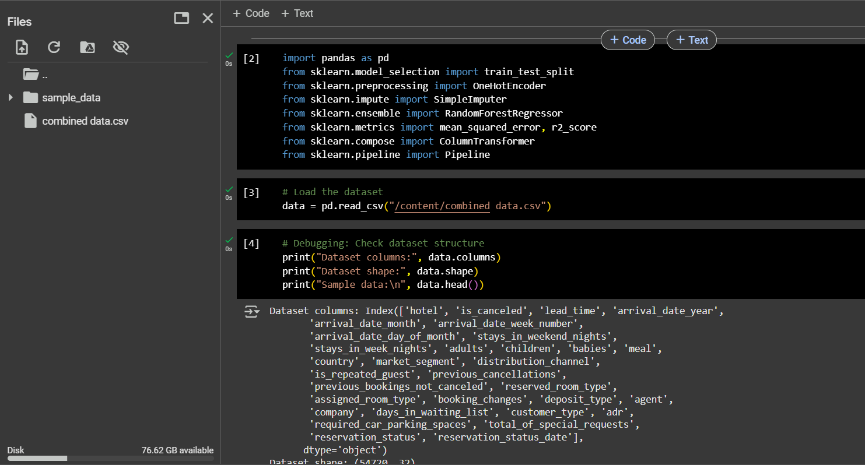
Importing Libraries
The code imports essential libraries:
pandas: For handling tabular data.
sklearn.model_selection: To split data into training and testing sets.
sklearn.preprocessing: For preprocessing tasks like encoding categorical data.
sklearn.impute: To handle missing values.
sklearn.ensemble: To use the Random Forest Regressor.
sklearn.metrics: To evaluate model performance using metrics like Mean Squared Error (MSE) and R² score.
sklearn.compose: For combining preprocessing steps.
sklearn.pipeline: To build a streamlined machine learning workflow.

Slide 16
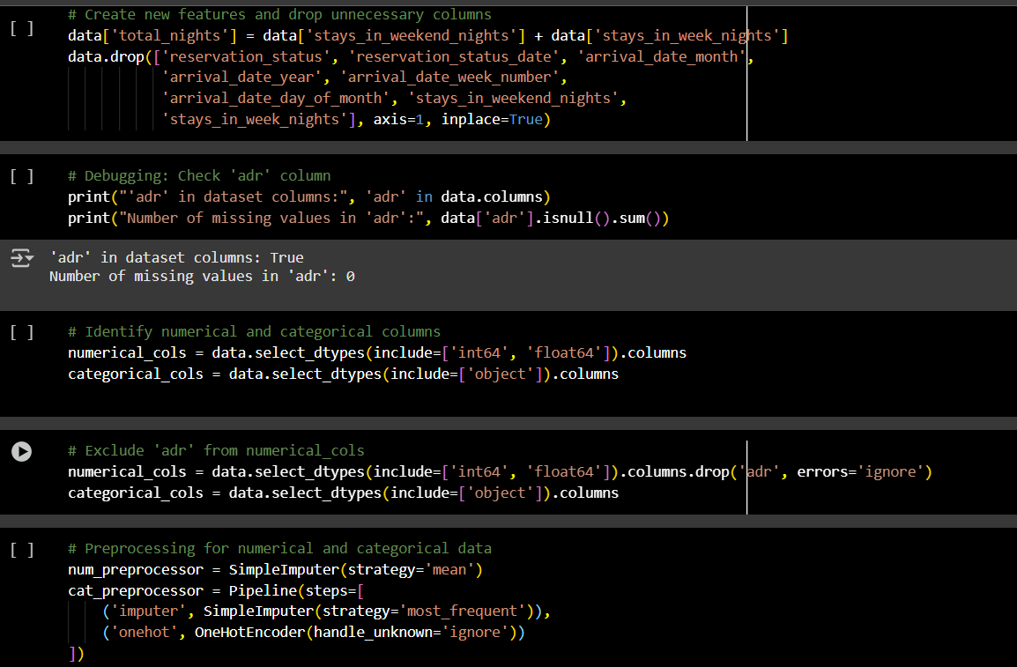
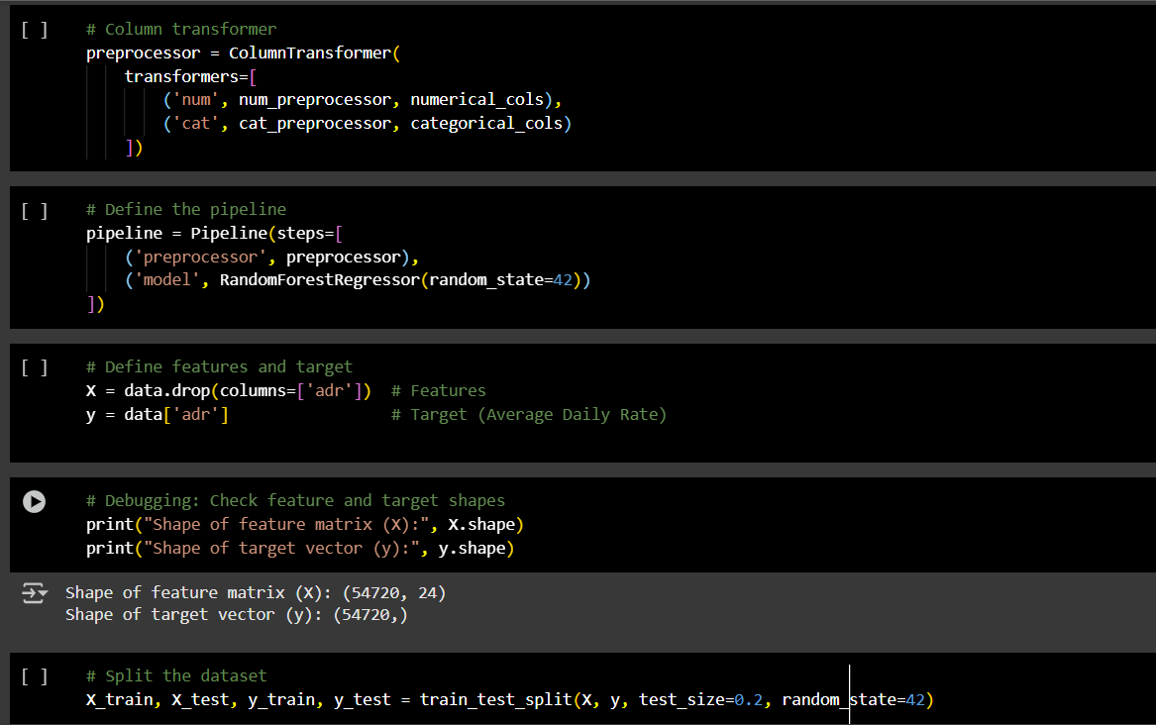

Slide 17
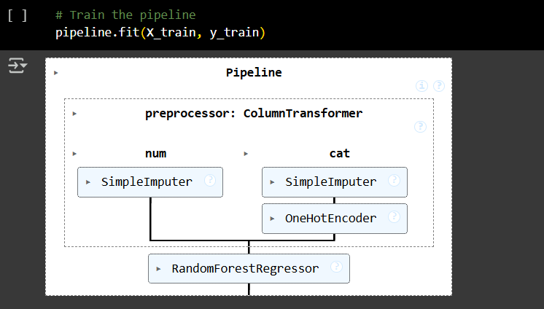
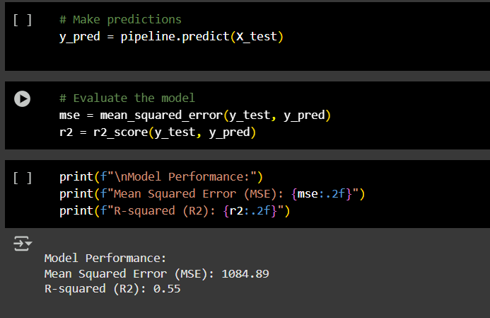
Mean Squared Error (MSE): Measures the average squared difference between predicted and actual values. Lower values indicate better performance.
MSE = 1084.89.
R-squared (R²): Indicates the proportion of variance in the target variable explained by the model. Higher values (closer to 1) indicate better performance.
R² = 0.55 (indicates 55% of the variance in the data is explained by the model).

Slide 18
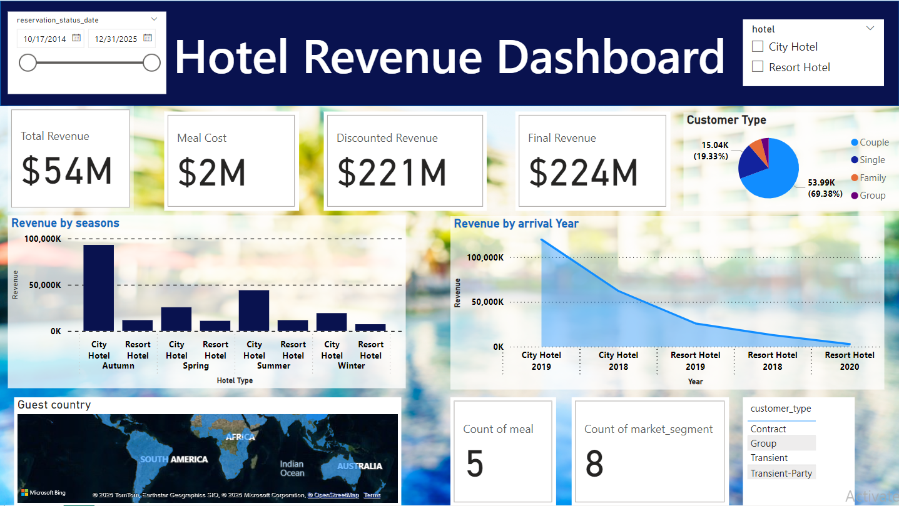
Hotel Revenue Dashboard

Slide 19
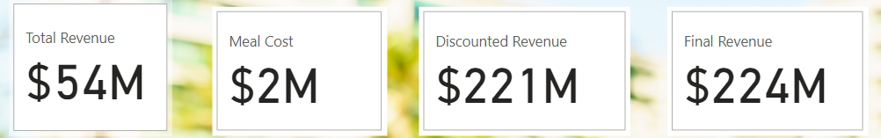
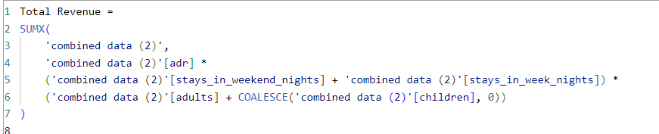
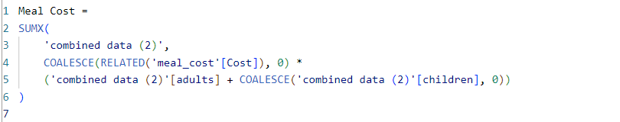
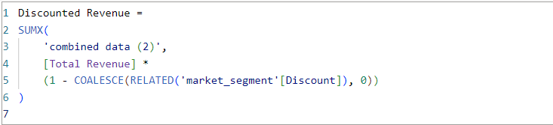
Power BI Data Pre-Processing

Slide 20

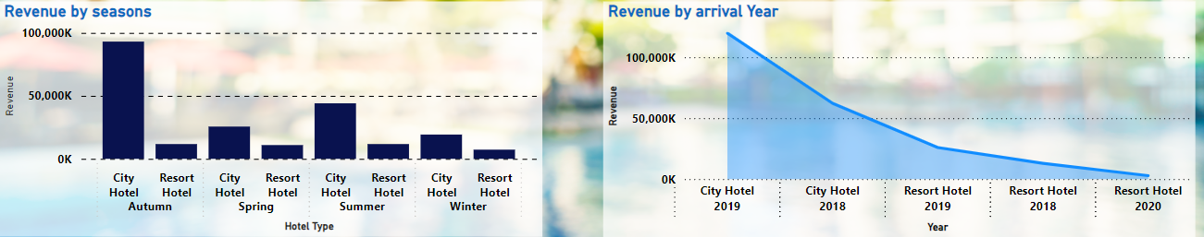



Revenue by Seasons
Autumn:
City Hotels: Generate the highest revenue compared to all other seasons and hotel types, with a noticeable spike above $100K.
Resort Hotels: Revenue is significantly lower in Autumn compared to City Hotels.
Winter:
Revenue is lowest for both City and Resort Hotels, with Resort Hotels performing marginally better than City Hotels.
Spring:
Both City and Resort Hotels generate relatively low revenue, with a slight edge for Resort Hotels.
Summer:
City Hotels again lead in revenue, with Resort Hotels closely following. This season shows better performance than Spring and Winter for both hotel types.

Slide 21
Predictions Based on the Data
City Hotels Dominate in Autumn:
The spike in City Hotel revenue during Autumn suggests higher demand in urban areas during this time. This could be linked to business travel, conferences, or events commonly scheduled in Autumn.
Prediction: This trend is likely to continue unless there's a major change in market conditions, as the seasonal preference for City Hotels in Autumn seems consistent.
Resort Hotels Perform Well in Summer:
Summer months align with vacation periods, making it a strong season for leisure-oriented Resort Hotels.
Prediction: Resort Hotels will likely see consistent demand in summer seasons, particularly if they target families or tourists during holidays.
Low Demand in Winter:
Both hotel types experience their lowest revenue in Winter, possibly due to reduced travel during the off-peak season or harsh weather conditions.
Prediction: Winter will continue to be a weak season unless promotional campaigns or events drive more bookings.
Growth Potential for Spring:
Spring shows modest revenue but could grow with targeted marketing (e.g., focusing on festivals, spring break tourism, or outdoor events).
Prediction: Efforts to attract customers during Spring (e.g., discounted packages, seasonal offerings) might slightly boost revenue.

Slide 22
Revenue by Year
City Hotels:
Peak in 2019: Revenue for City Hotels reached its highest point in 2019, indicating strong demand for urban accommodations that year.
Decline After 2019: After the peak in 2019, there is a sharp decline in revenue for City Hotels in subsequent years. This could be attributed to external factors like reduced business travel, global economic shifts, or the impact of the COVID-19 pandemic (2020).
Resort Hotels:
Steady Decline (2018–2020): Resort Hotels show a consistent decline in revenue over the years. Unlike City Hotels, there’s no evident peak, suggesting stagnation or a lack of growth in demand for Resort Hotels.
Lower Revenue Overall: Resort Hotels have consistently generated less revenue compared to City Hotels, which could indicate a smaller target market or less efficient operations.

Slide 23
Predictions Based on Trends:
City Hotels:
If the decline seen post-2019 is tied to temporary factors (e.g., pandemic-related disruptions), revenue might recover as travel normalizes.
However, long-term trends like increased remote work or virtual meetings might limit growth in business travel, potentially capping revenue recovery for City Hotels.
Resort Hotels:
Resort Hotels could see a slower recovery due to their steady decline and competition from alternative accommodations (e.g., vacation rentals).
They might experience a rebound if leisure travel and "staycation" trends gain popularity, especially in post-pandemic years.
Revenue Levels (2021+):
Without interventions, both hotel types are likely to experience slow revenue growth or even stagnation in the short term.
Predictive models using external factors (e.g., tourism statistics, economic recovery rates) could provide more clarity on when and how revenue might recover.

Slide 24
Actionable Recommendations
City Hotels
Leverage their dominance in Autumn and Summer by optimizing pricing and promotional packages.
Focus on business travelers and events to recover lost revenue since 2019.
Resort Hotels
Capitalize on Summer demand by offering family and group vacation packages.
Address the steady decline in revenue by diversifying offerings and targeting untapped customer segments.
Seasonal Strategies
Boost Winter and Spring performance through targeted discounts, bundled packages, and events (e.g., winter getaways, spring festivals).
Customer Segmentation
Focus on retaining and growing the Family customer base, which accounts for the majority of revenue.
Develop campaigns for Couples and Groups to diversify the customer mix.
Geographic Focus
Identify top-performing countries and regions from the map visualization and develop marketing strategies to attract guests from these areas.

Slide 25
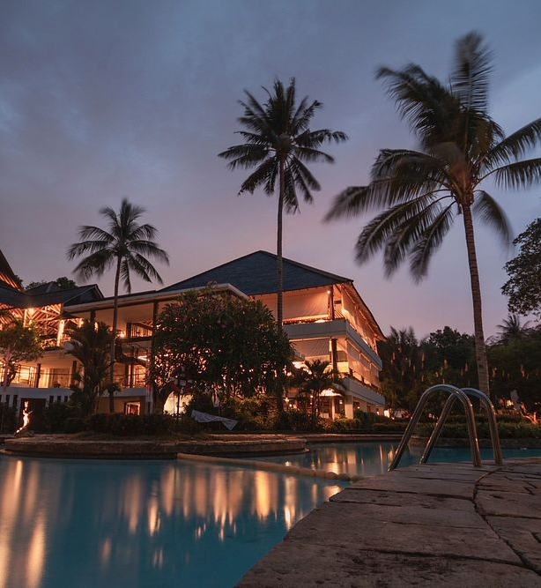
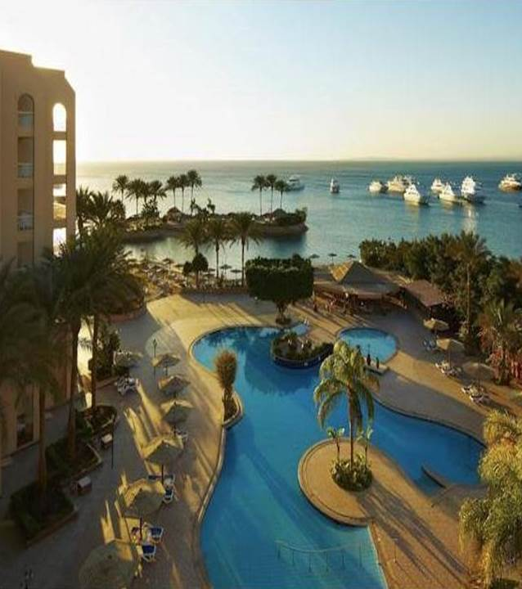

Conclusion
The dashboard reveals that City Hotels outperform Resort Hotels, with peak revenue in Autumn, while Resort Hotels excel in Summer but face steady decline.
Families are the largest customer segment, while Groups offer growth potential.
Revenue dropped significantly post-2019, likely due to global disruptions.
Winter and Spring are low-performing seasons, presenting opportunities for targeted promotions.
To drive growth, hotels should focus on seasonal strategies, expand offerings, and tailor packages to customer segments.

Slide 26


Thank you

